Slide 1
Classically Punk
Music multi-class classification
Nikolay Kirilov, student at Amsterdam Tech

Slide 2
Problem definition
The goal is to understand and extract as much as possible data from audio files.
To train a model that can classify an audio file as a given genre
The success criteria is to achieve F1 score of more than 71% which is the F1 score of the baseline LogisticRegression model.

Slide 3
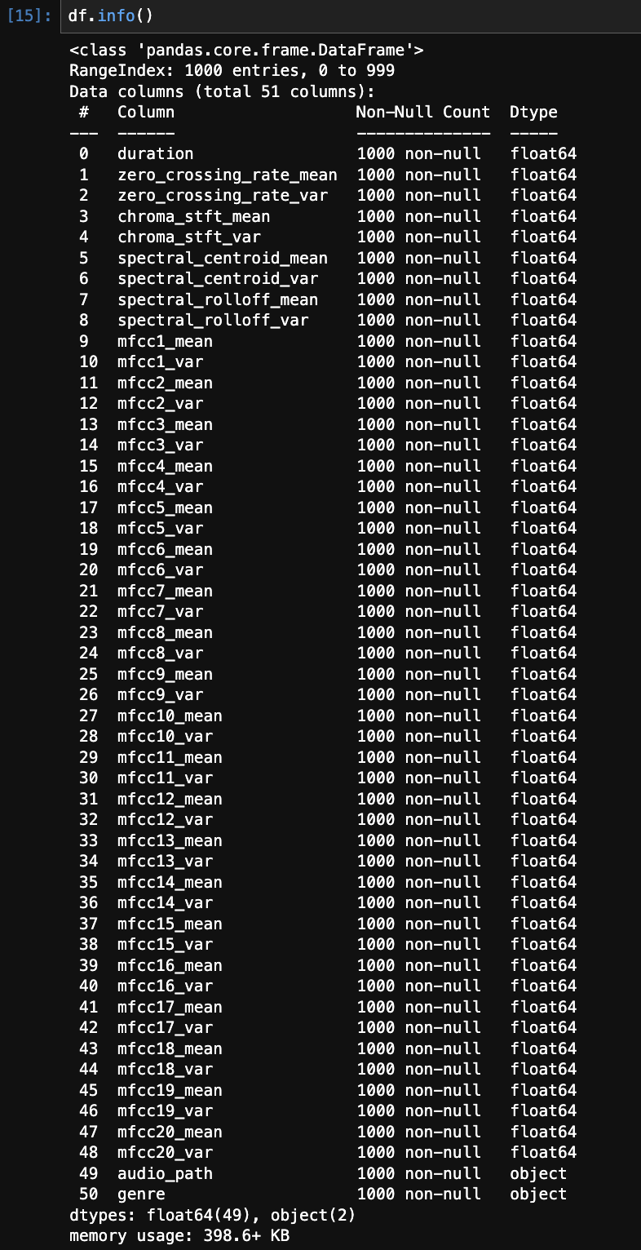
Data
The genres data can be found on Kaggle: https://www.kaggle.com/datasets/andradaolteanu/gtzan-dataset-music-genre-classification
I have extracted multiple features and engineered more, so now we have 1000 samples and 51 features.

Slide 4
Data - features
Feature 1 - Zero Crossings - The zero-crossing rate is the rate of sign-changes along with a signal, i.e., the rate at which the signal changes from positive to negative or back.
Feature 2 - Spectral Centroids - It indicates where the " center of mass" for a sound is located and is calculated as the weighted mean of the frequencies present in the sound.
Feature 3 - Spectral Rolloff - It is a measure of the shape of the signal. It represents the frequency below which a specified percentage of the total spectral energy, e.g., 85%, lies.
Feature 4 - MFCCs - The Mel frequency cepstral coefficients (MFCCs) of a signal are a small set of features (usually about 10–20) that concisely describe the overall shape of a spectral envelope.
Feature 5 - Chroma Frequencies - Chroma features are an interesting and powerful representation for music audio in which the entire spectrum is projected onto 12 bins representing the 12 distinct semitones (or chroma) of the musical octave.

Slide 5
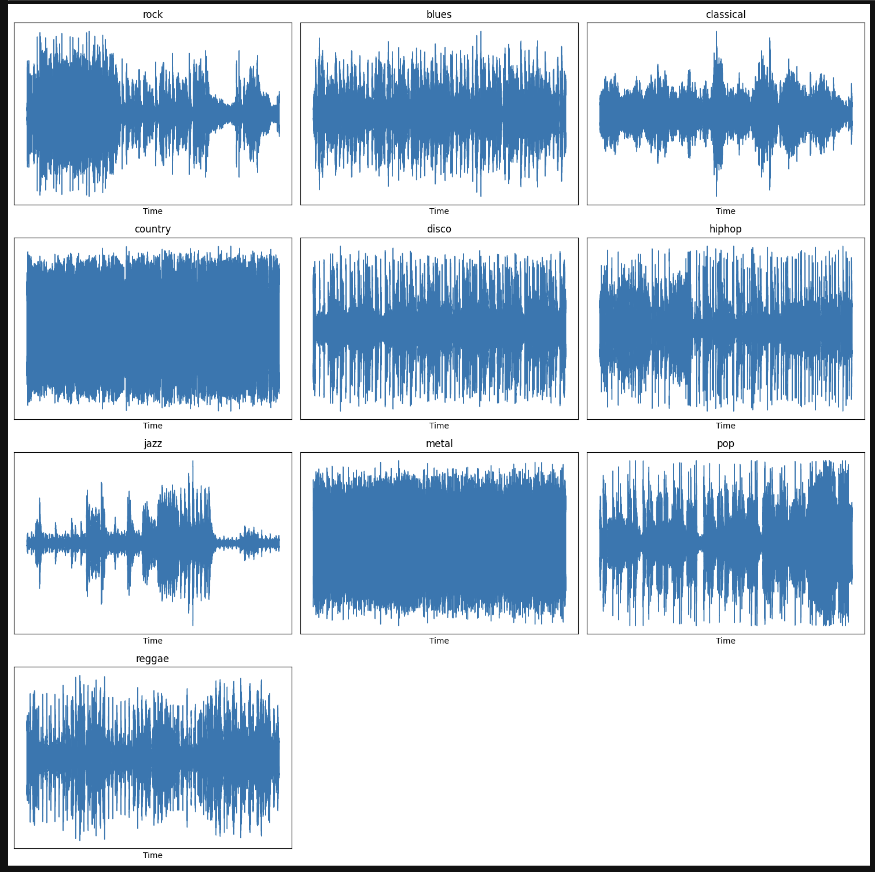
Exploratory Data Analysis
I started with exploring how an audio file of each genre looks like as a melogram.

Slide 6
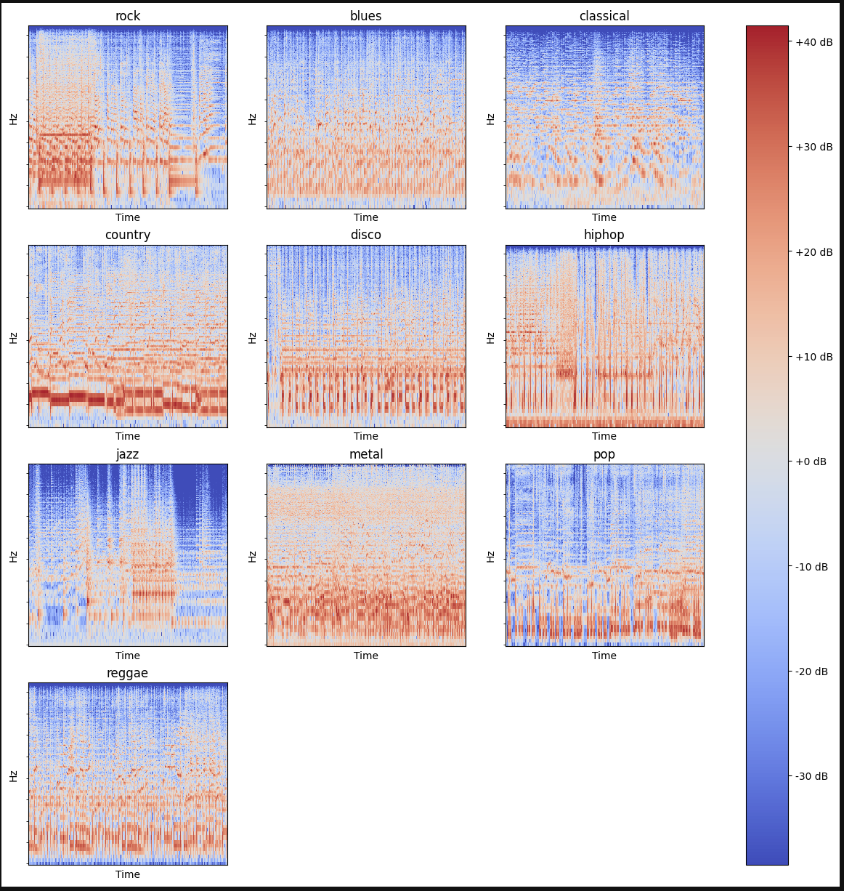
Exploratory Data Analysis
Then, I explored how an audio file of each genre looks like as a spectrogram.

Slide 7
Data Preprocessing
Having in mind, I have generated the dataset, there were no null values, so the dataset was pretty clean. I implemented label encoding for the target variable and utilized RobustScaler for the other features. Even though, I have started with StandardScaler, during the modeling part it turned out that there are some outliers, so the RobustScaler performed around 20% better. The feature engineering part was performed earlier while extracting the features themselves from the audio files.

Slide 8
Methodology
As a classification problem, I utilized LogisticRegression from scikit-learn library as a baseline model that achieved F1 score of 71%. I created a neural network using PyTorch. In the beginning I splitted the data to train/test/val - 60/20/20. However, it turned out that the train data samples are too little so I needed to increase the train data. Then, I had too little test and validation data. Finally, I switched to train/test data only with 70 to 30 split, and I utilized k-fold cross-validation because of the small number of samples available.

Slide 9
Experiments & Results
I have conducted numerous experiments. All of them can be seen on MLFlow which I used to log the parameters and metrics. In the beginning, I have started with a simple model. Then, I started adding more and more layers - ReLU, Linear, Dropout steps and BatchNorm1d. At some point, I ended with more than 30 layers, really slow network, and not good enough model. I performed a research and contacted my mentor, he mentioned a paper by Google that suggests a scientific approach for model improving. Inspired by it, I started from the beginning with more logging and deeper analysis after each step. After all, I have achieved a somewhat good network with a cross-validated mean F1 score of ~81%.

Slide 10
Conclusion & Future work
In conclusion, I learnt a lot about music and especially the audio files - how they look like, what features can be extracted and how the data is described. The neural network I built is not the best, however, I would say the data size is small. Based on the difference of about 7-8% in the score after the increase of the number of train samples, I believe with more data the model will be more accurate.
During the researching and working, I found that there is another way to implement this solution and it is by analysing the images from the melograms and spectrograms. This would be a perfect continuation of the project as future work.

